Slide 1
Vehicle Type Classification
UC Berkeley
W281 Computer Vision
Scott Kao
Amir Sotoodeh
Steven Tong
Notes:
Steven

Slide 2

Motivation and Problem Statement
Use Case
Used car online sales - autofill vehicle type base on image
Traffic analysis - traffic patterns and vehicle types
Public safety - automatic detect suspect vehicles
Problem Statement
Can we classify the vehicle type based on the vehicle image?
Notes:
Steven

Slide 3


Proposed Method
Exploratory Data Analysis (EDA)
Image preprocessing
Feature extraction and experiment
Dimensionality reduction (PCA)
Model building and experiment
Hyper parameter tuning
Evaluating results
Notes:
Steven

Slide 4
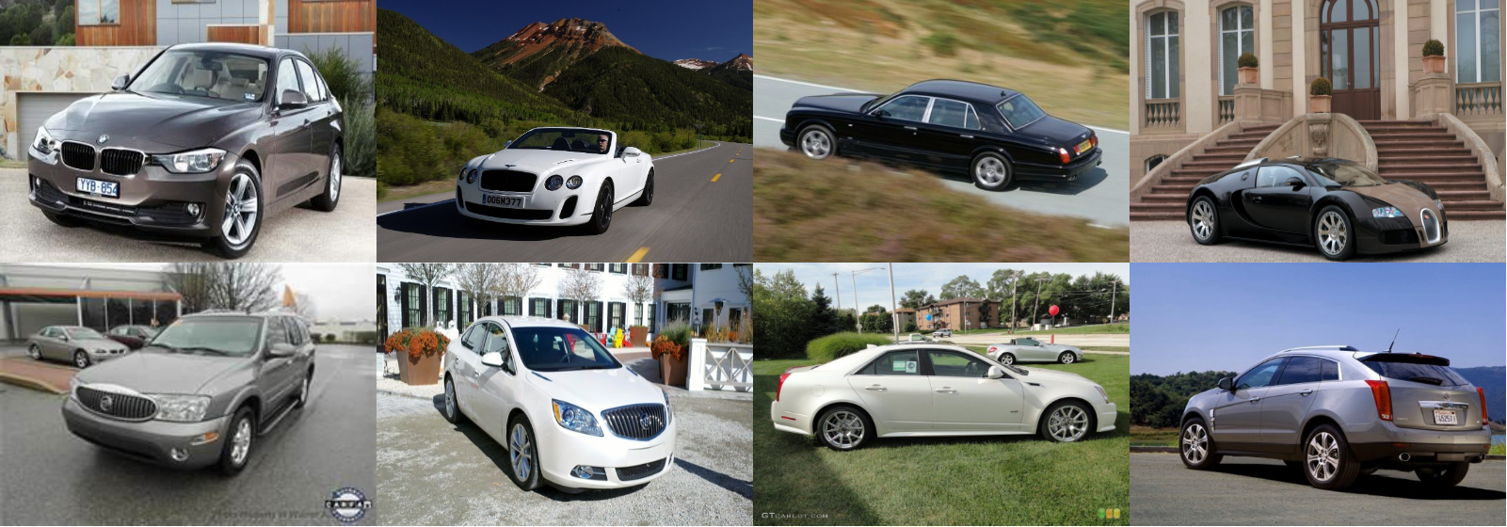
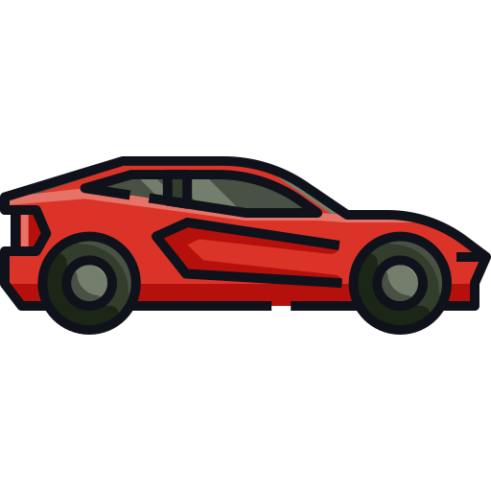
Stanford Car Dataset
16,185 images of 196 classes of cars.
8,144 training images
8,041 testing images
Each class split roughly in a 50-50 split.
Make, Model, Year, Bounding Boxes
Notes:
Steven

Slide 5
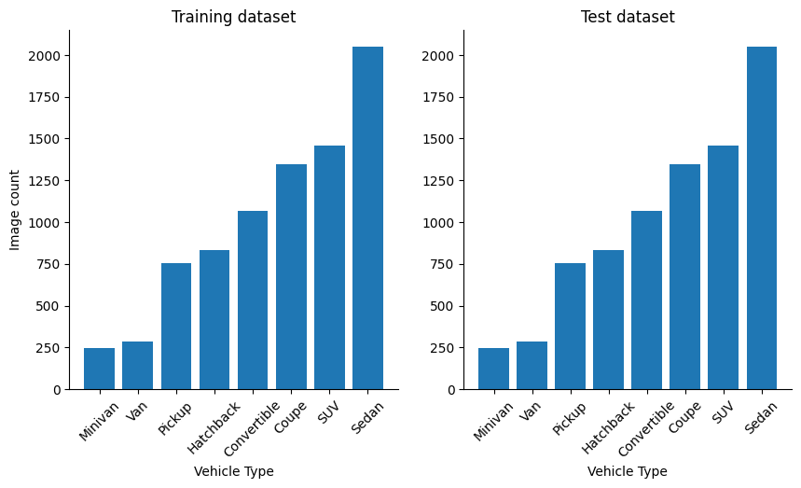
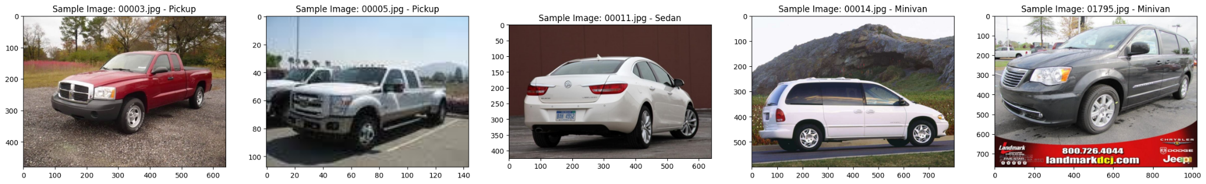
Exploratory Data Analysis
Image classes are not balanced
Label file contains bounding box information
Downsize over representing classes
Notes:
Steven

Slide 6
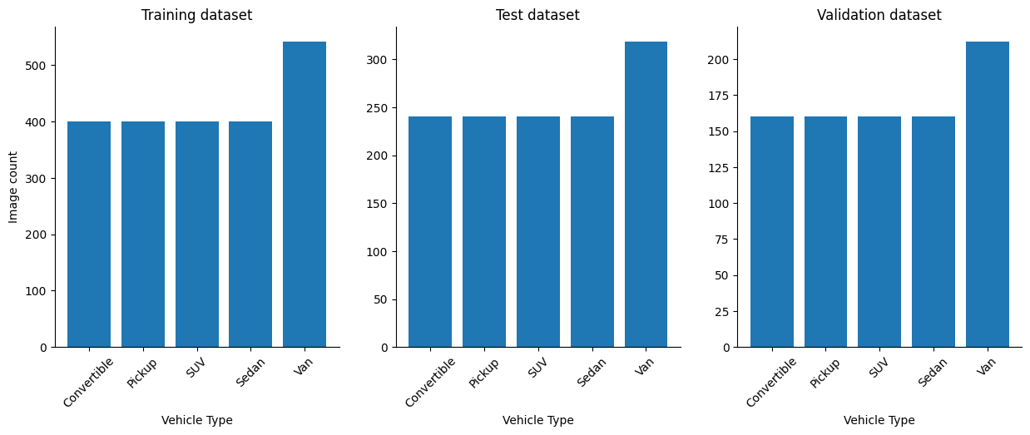
Training, Validation, Test Data Split
50% Training
20% Validation
30% Test
Notes:
Steven

Slide 7
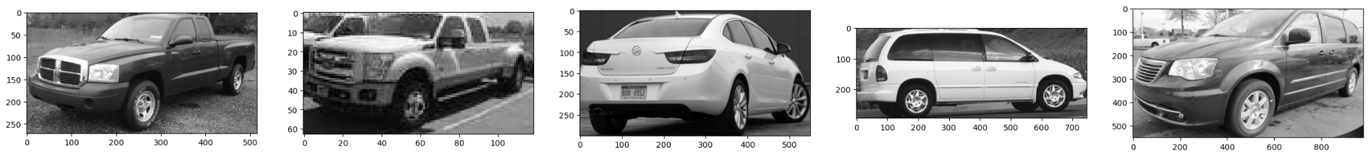
Image Preprocessing
Cropped ROI (based on labeling file)
Convert to grayscale
Resize (224 x 224)
Apply Gaussian blur (5 x 5)
Notes:
Steven

Slide 8
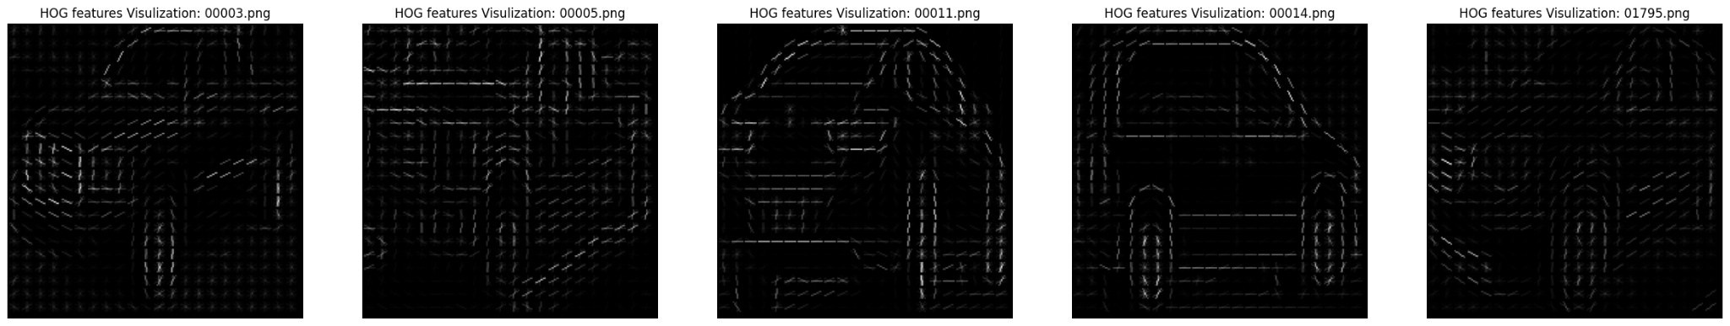
Feature Extraction - HOG
Compute a histogram of gradient orientations in a small region
HOG(image, orientations = 9, pixels_per_cell = (10, 10), cells_per_block=(2, 2))
Notes:
Steven

Slide 9
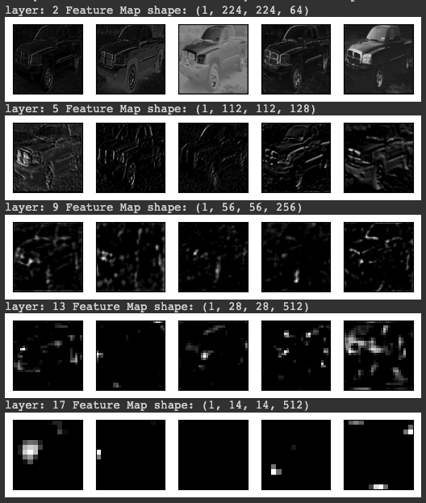
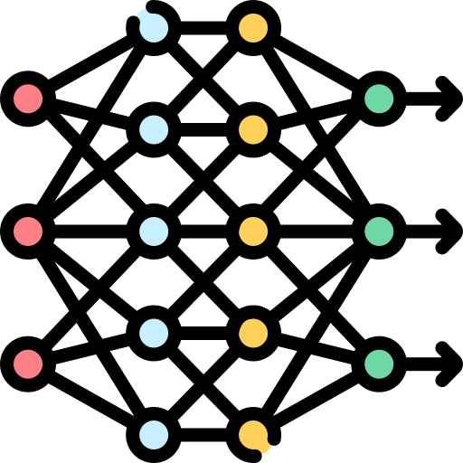
Feature Extraction - VGG16
Weight = imagenet
Total 16 layers
More abstraction after each layer
Notes:
Steven

Slide 10
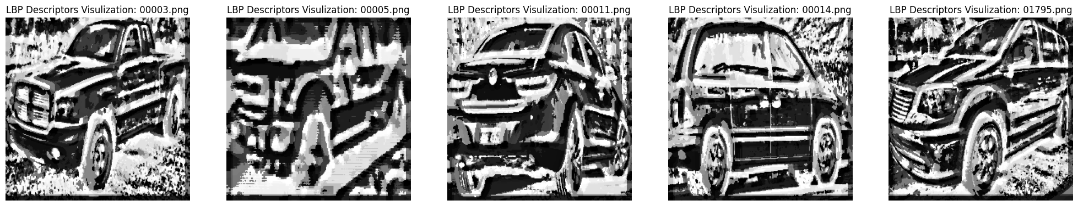
Feature Extraction - LBP
High discriminative power for distinguishing texture.
lbp = local_binary_pattern(image, P=8, R=8)
hist, _ = np.histogram(lbp, bins=256, range=(0, 256))
Notes:
Andrew

Slide 11
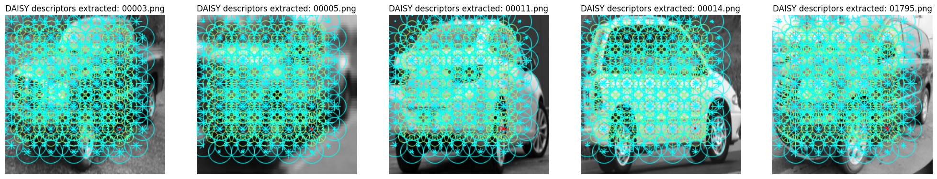
Feature Extraction - Daisy
features = daisy(image, step=64, radius=64, rings=2, histograms=8, orientations=8)
Notes:
Andrew

Slide 12
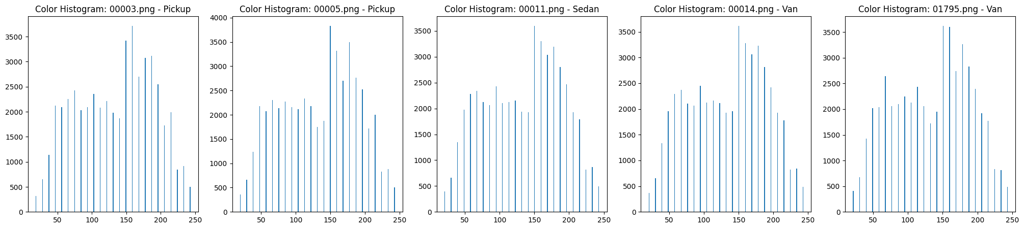
Feature Extraction - Color Histogram
Single channel (grayscale)
25 bins
Does not appear to be distinguishable among different classes
Notes:
Scott
The next feature we are looking at is the color histogram. We used preprocessed, single channel image from training dataset and study the pixel value variation. To reduce the noise, we bin the values into 25 bins, and you can see on the screen for the same 5 vehicles that we can been studying. As you can see, all color histogram looks very similar, indicating this may not be a useful feature in our model.

Slide 13
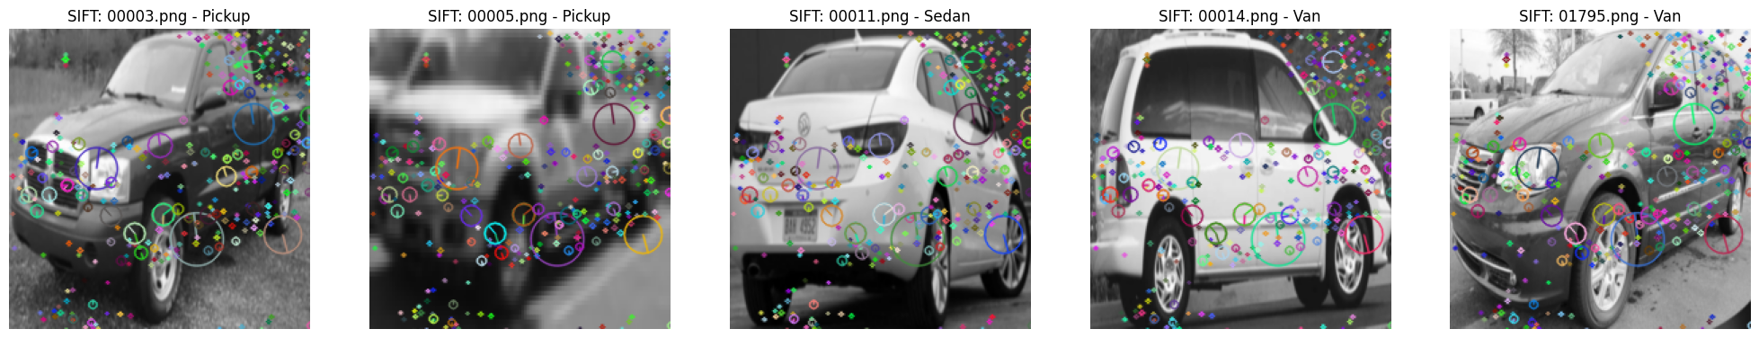
Feature Extraction - SIFT
Randomly select 50 SIFT features from each image
Use VBOW (Visual Bag of Words)
K-means clustering (200)
Extract all features and categorized them to clusters
Create histogram for modeling
Notes:
Scott
We now look at SIFT feature. SIFT, or Scale Invariant Feature Transform, extracts keypoints and compute its descriptors. On the screen you can see how these feature visualized, again using the same vehicles we used before. Because every image has different number of keypoints, we will randomly select a number of features from each image, in our model we use 50, and build a sample subset. We then use K-Means to classify them into 200 clusters. We then go back to the original image, this time extract all keypoints, predict their cluster, and consolidate the result into histogram. This 200 bin histogram then becomes our feature vector.

Slide 14
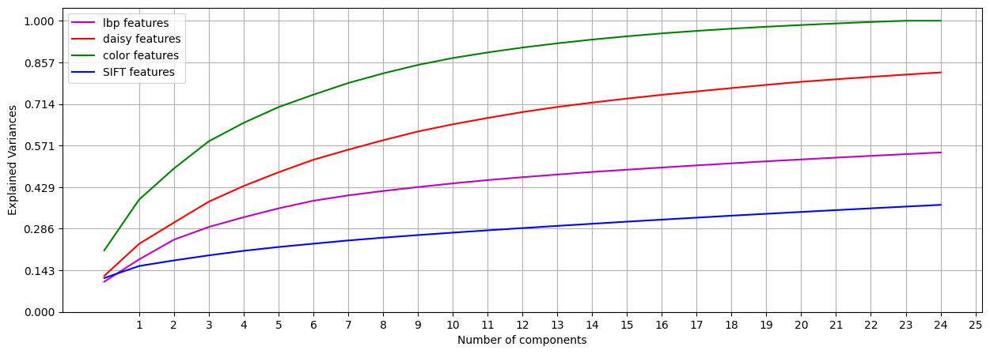
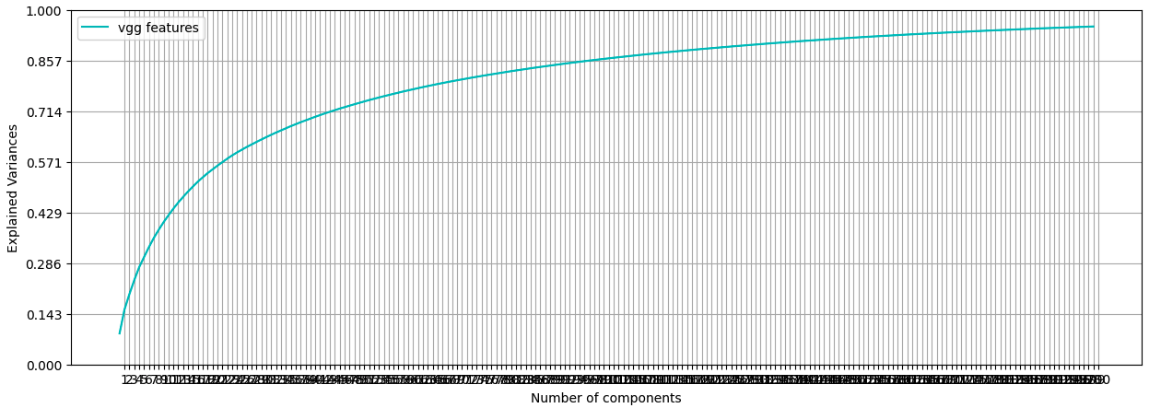
PCA
Color feature has only 25 components
LBP takes over 200 components to be close to 1
Daisy features can get high explained variance with 150 components
SIFT feature can get explained variance to 1 with 200 components
Notes:
Scott
Now we have all the features, we then proceed with PCA and tSNE analysis. Since different feature has different size of components, we need to separate them into different PCA plots to see how they perform. For example, while Daisy feature can get high explained variance with 150 components, LBP and SIFT takes over 200 components to have high enough explained variance.

Slide 15
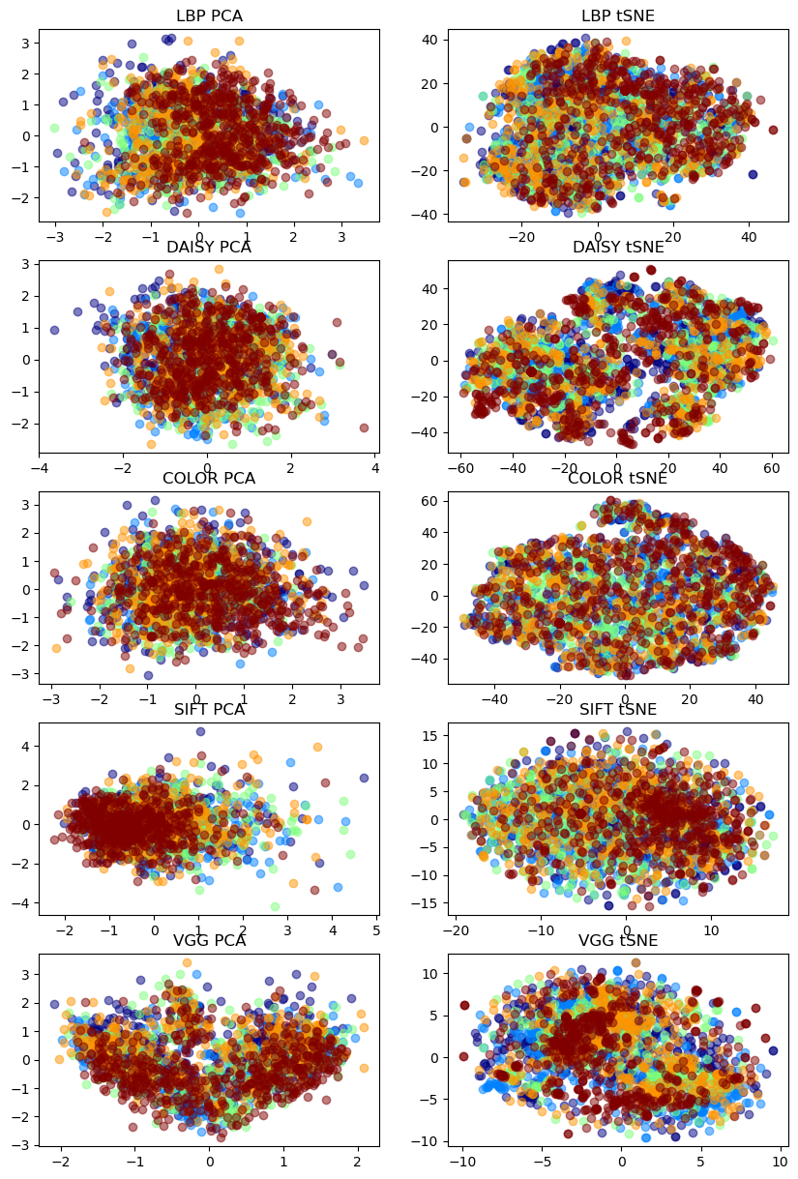
tSNE
VGG and and Daisy feature seem to have separatable boundaries among classes
Notes:
Scott
Now we plot the 2-D PCA and tSNE. While the plot on the right hand side of the slides may not be readable to you, we would like to call out VGG and Daisy features. These two features appears to show clustering among classes, which is an indicator that they may be useful features to be used in our modeling.

Slide 16
Model Iterations
Classifiers
SVM
XGBoost
Increase training data
The Sedan and Convertible class had the lowest accuracy.
Increased the images in training dataset from 400 images in category to 600 images.
Validation accuracy did not improve
Notes:
Scott
For our modeling, we will use two classifiers, SVM and XGBoost. In our early on model building experiment, we experienced overfitting. One of our attempts to mitigate the issue was to increase the training dataset by increasing from existing 400 images per class, to 600 images per class. This did not seem to improve the validation accuracy, which lead us to believe that our issue may not be related to lack of data, but rather lack of relevant features in our model.

Slide 17
Model Iterations
Low Impact Features
HOG
SIFT (150 components)
Haralick
Color Histogram (22 components)
High Impact Features
LBP (200 components)
VGG (200 components)
DAISY features (150 components).
In the final model, we chose to only use VGG16 feature.
Notes:
Scott
For our feature vector building, we started with single feature, with HOG, SIFT, Haralick, color histogram, and LBP. None of these feature generated good accuracy, which we will see later in the combined result slide. We then tried the combined features including color histogram + SIFT + Daisy, and the validate accuracy result was around 60%. This is when we started to try to increase the size of the training set, but like I mentioned earlier, we did not observe an increase in accuracy. When we tried out the Daisy feature by itself, we started to see the validation accuracy increased to 68%. Lastly, we looked into other features that we can use, and eventually we identified VGG16 single feature gives us the best validation accuracy without overfitting.

Slide 18
Hyperparameter Tuning
Features
LBP
P = 8, R = 8
Color Histogram
256 bins -> 25 bins
Daisy
Various step and radius size from 16 -> 64.
64 Radius, 64 Steps performed best.
VGG16
Omitted
SIFT
Haralick
HOG
Classifiers
SVM: {'C': 1, 'gamma': 0.001, 'kernel': 'rbf'}
XGBoost: {'colsample_bytree': 0.75, 'learning_rate': 0.1, 'max_depth': 6, 'min_child_weight': 1, 'subsample': 1}
Notes:
Andrew
Leaving here as backup:
SIFT
Random selected features from 20 to 200. The result changed was not obvious. 50 provided slightly better result
Clustering from 200 to 2000. Modeling perform did not improve as clustering go beyond 200, and it took extensive time to fit K-means with 500+ clusters.

Slide 19
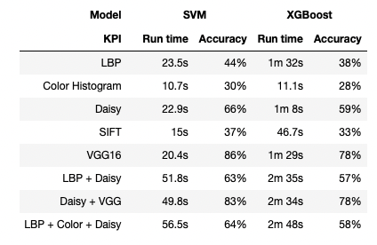

Slide 20
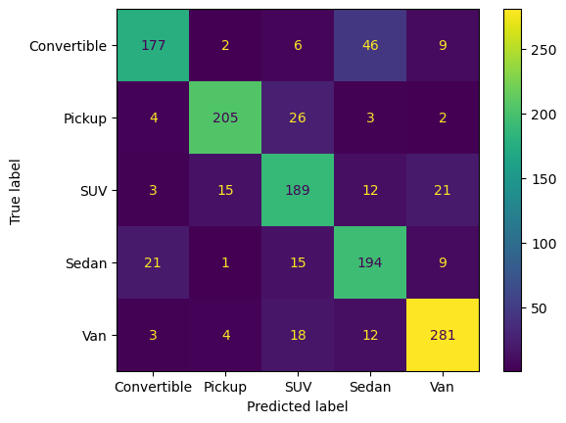

Results with VGG16 Feature
SVM
(Accuracy 82%)
XGBoost
(Accuracy 77%)
Notes:
Andrew

Slide 21
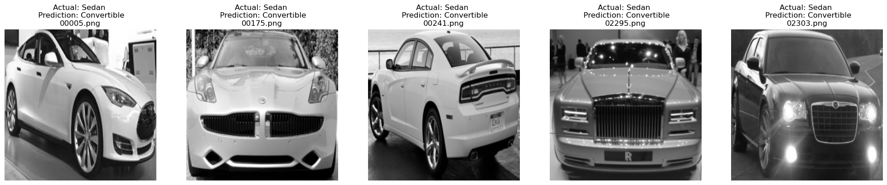
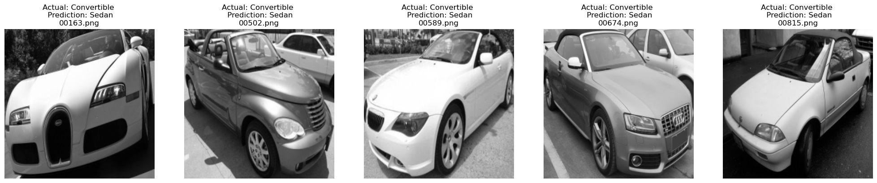
Predictions Analysis
Similar Angles
Top is obscure, or blended into the background
Notes:
Andrew

Slide 22
Discussion
The model frequently mistakes sedans and convertibles.
Most models slightly overfit, with maxed out validation and test accuracy at 82%.
Adding more features does not necessarily increase accuracy (combining LBP/Color/Daisy vs Daisy only)
Adding advanced feature (VGG16) takes extensive amount of processing time, but have rich feature extraction capabilities.
SVM in general, performs better than XGBoost for this particular dataset.
Notes:
Andrew

Slide 23
Thank you!

Slide 24
References
Standard Car Dataset
https://www.kaggle.com/datasets/jessicali9530/stanford-cars-dataset?resource=download
https://projet.liris.cnrs.fr/imagine/pub/proceedings/ICME2011/HTML/Papers/MainConference/paper_708.pdf
https://github.com/flytxtds/scene-recognition/blob/master/scene_recognition_short_paper.pdf
SIFT (Bag of features) + SVM for classification
https://liverungrow.medium.com/sift-bag-of-features-svm-for-classification-b5f775d8e55f

Slide 25
Efficiency vs. Accuracy
Model | KPI | LBP | Color | Daisy | SIFT | VGG16 | LBP + Daisy | Daisy + VGG | LBP + Color + Daisy
SVM | Run time | 23.5s | 10.7s | 22.9s | 15s | 20.4s | 51.8s | 49.8s | 56.5s
SVM | Accuracy | 44% | 30% | 66% | 37% | 86% | 63% | 83% | 64%
XGBoost | Run time | 1m 32s | 11.1s | 1m 8s | 46.7s | 1m 29s | 2m 35s | 2m 34s | 2m 48s
XGBoost | Accuracy | 38% | 28% | 59% | 33% | 78% | 57% | 78% | 58%

